Slide 1
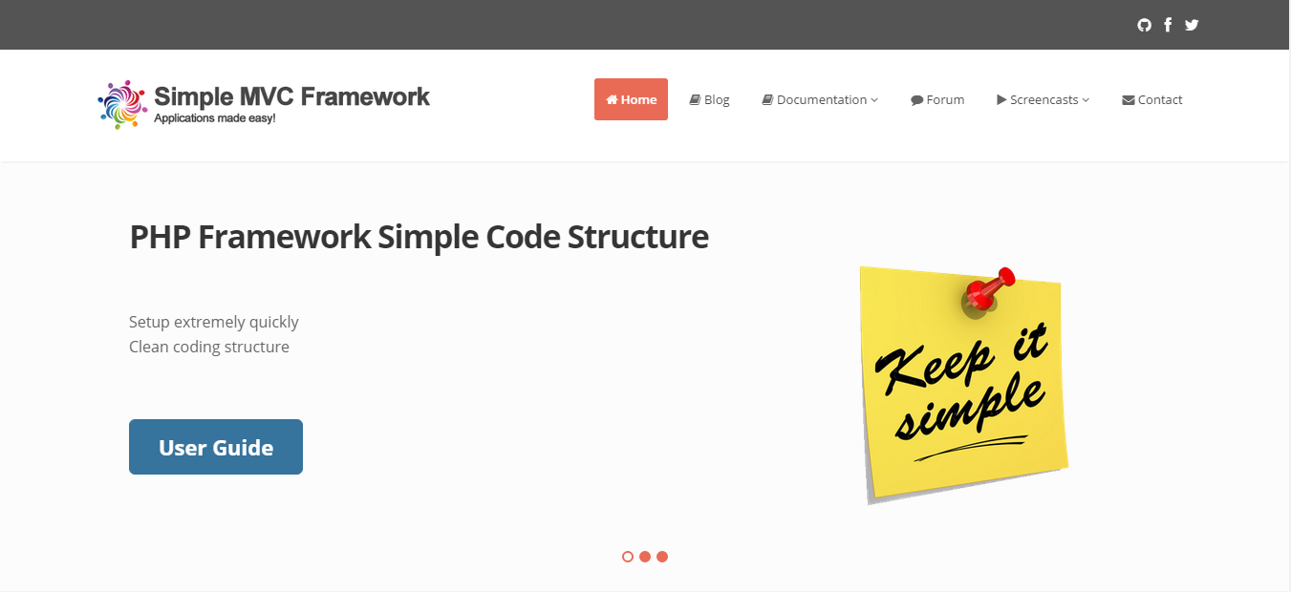
Simple MVC framework
Trang chủ: http://simplemvcframework.com/php-framework

Slide 2
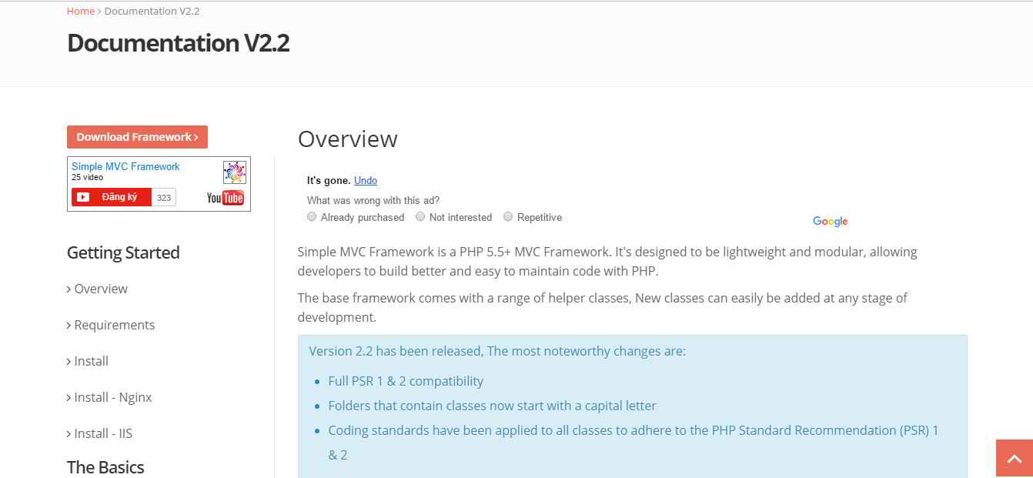
Getting started with simple MVC framework
http://simplemvcframework.com/documentation/v2.2/overview

Slide 3
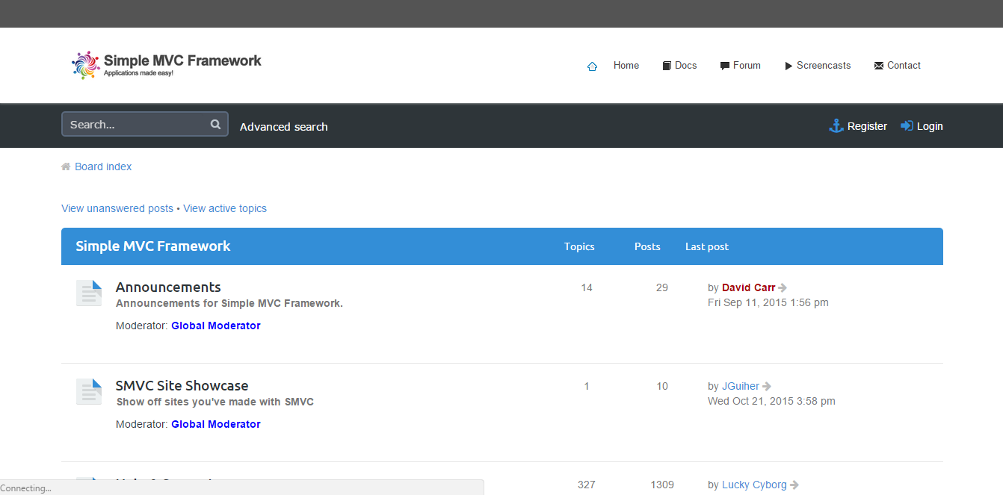
Forum of simple mvc framework
http://simplemvcframework.com/forum/

Slide 4
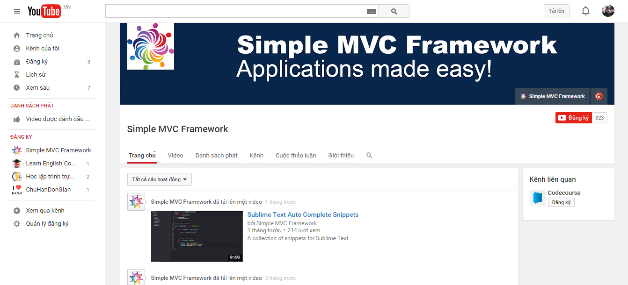
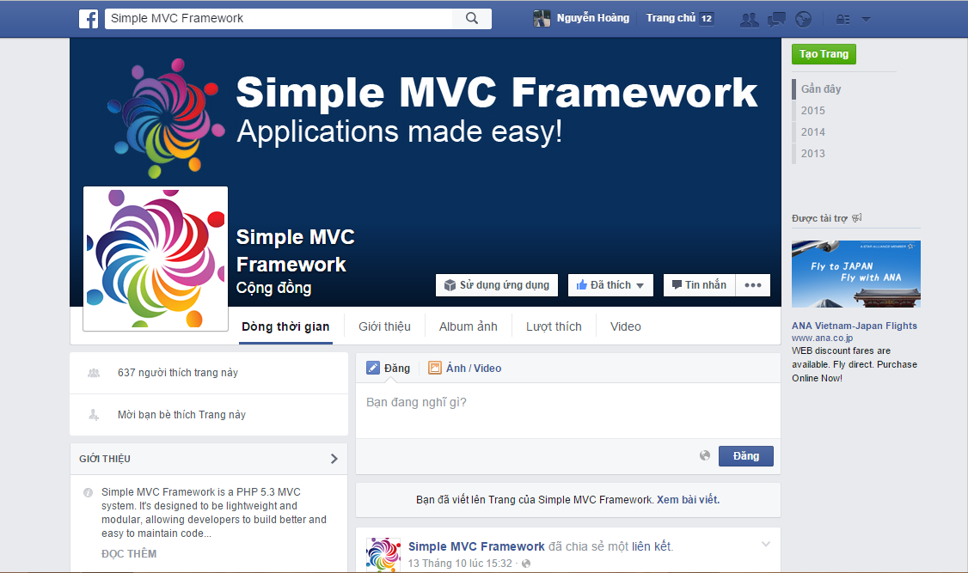
Youtube channel and Facebook channel
Youtube: https://www.youtube.com/user/simplemvcframework?feature=sub_widget_1
Facebook: https://www.facebook.com/simplemvcframework

